Slide 1
Team 60 Project Proposal Presentation
Modeling and Forecasting Hotel Booking Cancellations

Slide 2
Team Members
Andrea Kirksey
Dakota Coomes
Gurman Singh
Jiangqin Ma
Duarte-Nuno de Sousa

Slide 3
Agenda
Problem Statement/Background/Hypothesis
Exploratory Data Analysis
Analytical Method and Models
Research Summary

Slide 4
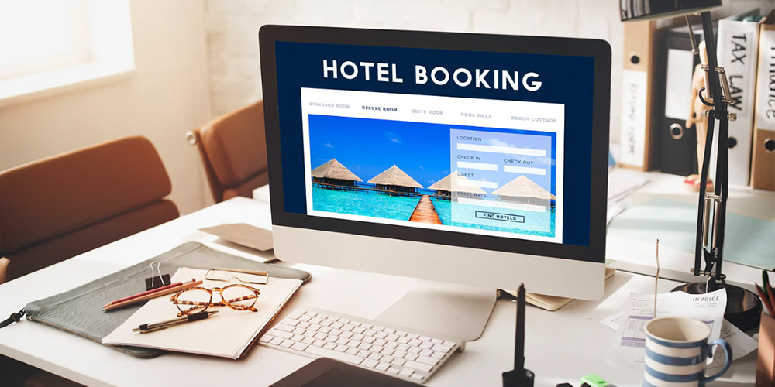
Background and Problem Statement
Hotel reservations and cancellations pose a risk to the hotel business often with no financial recourse
Mitigate this risk by modeling and forecasting hotel booking cancellations
Allow hotel businesses to better plan and maximize room utilization
Problem Statement: Determine what factors impact hotel booking cancellations and forecast future booking cancellations.

Slide 5

Research Questions
Can hotel booking cancellations be modelled and forecasted using data on customer profiles, booking profiles, and time of year?
Are hotel booking cancellations seasonal?
Are hotel booking cancellations affected by hotel profile?
Does family size/make-up impact booking cancellation propensity?
Do hotel booking cancellations show an increasing/decreasing trend?
Notes:
Can talk about our hypothesis as answers to these questions in this slide

Slide 6
Initial Hypothesis
Winter cancellations
City hotels vs. Resort hotels
Booking cancellations trend
Large groups or families compared to individuals on business trips
Notes:
Maybe remove some text and add code snippets here?
Add box plot-Nuno

Slide 7
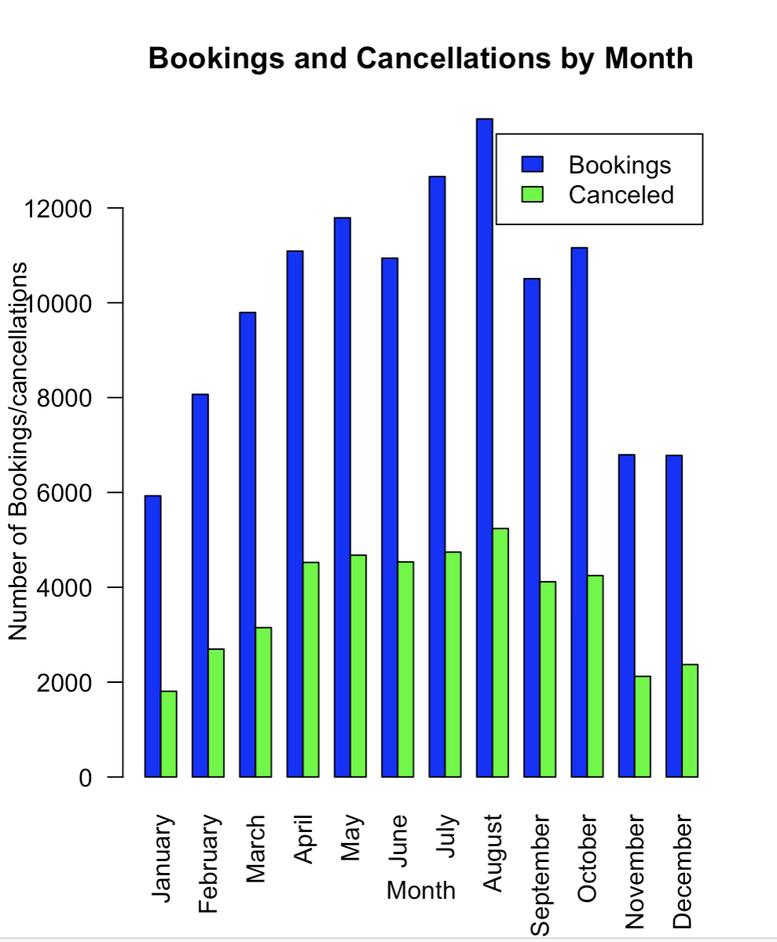
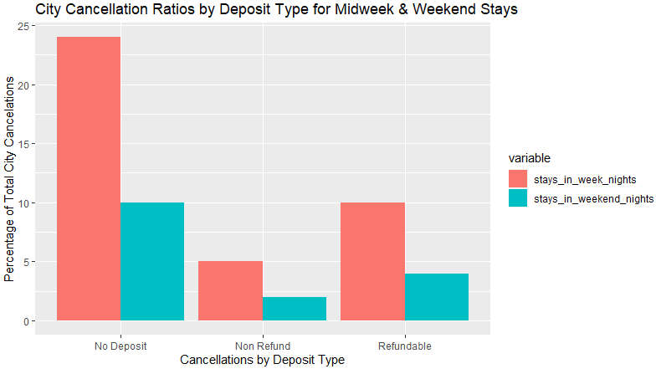
Exploratory Data Analysis
Overall cancellation rate is approximately 37%, with lowest rates during Winter months (33%)
City hotel cancellations were higher at ~42%, again with the lowest rate in Winter (40%)
Resort hotel cancellations were noticeably lower at 28%, once more the lowest rates in Winter (22%)
Notes:
Deposit type is a highly correlated variable for both hotel types

Slide 8
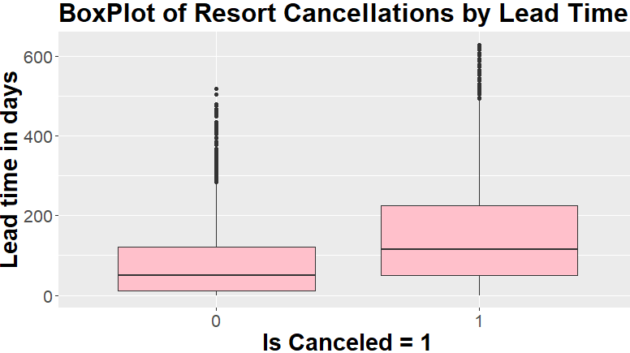
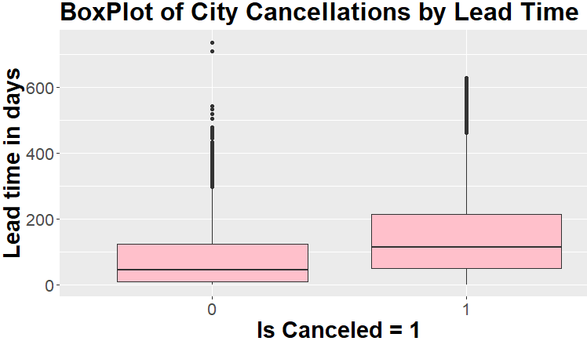
Exploratory Data Analysis cont.
Resort and City Hotels display similar correlations to the dependent variables, but in disproportionate degrees
Independent Variables | Resort Cancellations
Is Domestic | 0.286
Deposit type | 0.271
Lead Time | 0.229
Market Segment | 0.137
Distribution Channel | 0.125
Independent Variables | City Cancellations
Deposit type | 0.518
Is Domestic | 0.378
Lead Time | 0.235
Special Requests | 0.168
Previous Cancellations | 0.145
Notes:
Resort and City Hotels display similar correlations to the dependent variables, but in disproportionate degrees.

Slide 9
Overview of analytical method and models
Logistic regression to determine how parameters affect likelihood of hotel booking cancellation
KNN and SVM model for classification
Holt-Winters forecasting and exponential smoothing to determine periodicity and trend in booking cancellations throughout the year
Notes:
Create a confusion matrix to summarize the classifications
Plot ROC Curve and AUC to analyze sensitivity and specificity with different thresholds
Tune C and K hyper-parameters
Split the dataset into training, validation, test sets. Use predict accuracy to compare the models

Slide 10
Research
Main reasons for hotel booking cancellations could be due to unexpected events (natural disasters, pandemics, civil unrest, etc.)
PNR (Personal Name Record) data has been utilized to create A.I. models (SVM) to forecast near-term cancellations (4-7 days) with ~70% accuracy
Hotel PMS and customer PNR is utilized to create machine learning model (decision trees & forest) to predict cancellations with AUC > 0.90
Future research could use variables from data sources such as:
weather, competitive, intelligence, different types of hotels
Notes:
We can add more slides about research if needed

Slide 11
References
https://www.researchgate.net/publication/310504011_Predicting_Hotel_Booking_Cancellation_to_Decrease_Uncertainty_and_Increase_Revenue
https://www.sciencedirect.com/science/article/abs/pii/S2211973620300854
https://www.researchgate.net/publication/326824252_Modelling_the_cancellation_behaviour_of_hotel_guests

Slide 12
Thank You

Slide 13
Appendix

Slide 14
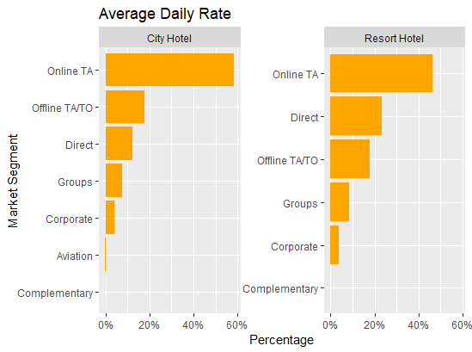
In terms of quantity and profitability: Online TA for both the city hotel & resort hotel, and direct booking of the resort hotel are the top market segments.
Independent Variables | Cancellation
Deposit type | 0.469
Lead time | 0.293
Total of special requests | 0.235
Distribution channel | 0.168
Booking changes | 0.145
Hotel Type | 0.137
Previous cancellations | 0.110
Notes:
Add Average rate chart-Andrea

Slide 15
SVM model
SVM stands for Support Vector Machines, which is a powerful machine learning algorithm for classification and regression.
SVM can handle linear and non-linear data by using different kernel functions, including linear, polynomial, radical basic function(RBF), and sigmoid kernels.
SVM can be computationally expensive and may require more processing power and time to train than other algorithms.

Slide 16
KNN model
KNN stands for K-Nearest Neighbors, which is also a type of machine learning algorithm for classification and regression analysis.
KNN predicts the class of a new data point based on the classes of its k nearest neighbors in the feature space. It is sensitive to the choice of k and the distance metric used to calculate the distances between data points.
KNN also requires a lot of memory to store the entire training dataset, and the process can be slow when dealing with large datasets.

Slide 17
The analysis of hotel booking data can inform various business decisions and marketing strategies, including:
Pricing strategy: Hotel booking companies can use hotel cancellation predictions to adjust prices and offer discounts to incentivize bookings.
Resource allocation: The analysis can help companies allocate their resources more efficiently. For example, if the model predicts that a particular hotel or location is more likely to have successful bookings, the company can focus its resources on promoting and advertising that hotel or location.
Customer targeting: Hotel booking companies can use hotel cancellation predictions to identify profitable customer segments and personalize marketing campaigns.
Risk management: Predictive models can help hotel booking companies predict high-risk bookings and take appropriate actions to minimize losses.

